Slide 1


EAST WEST COLLEGE OF ENGINEERING
Department of Electronics and Communication Engineering
Project Presentation A. Y: 2019-2020
on
“SMART PARKING SYSTEM USING IOT ”
Submitted by:
Name: Ajay Kumar C, Dhanush V, Nithin H
Semester: 8th
Department: ECE
Collage: East west collage of engineering
Under the Guidance of
Name: Prof. Murthy SS
Designation: Assistant Professor
Department: ECE
College: East west collage of engineering

Slide 2
CONTENTS
Objectives
Introduction
Literature Survey
Existing system
Proposed system
Methodology
Methodology description
Components description
Project planning
Flowchart
Working
Advantages
Applications
Conclusion
Reference

Slide 3
OBJECTIVES
The main aim of this project is to reduce the risk of finding the parking slots in any parking area.
Optimize Parking Space Usage.
It eliminates the unnecessary travelling of vehicles across the filled parking slots in the city.

Slide 4
INTRODUCTION
Smart Parking System (SPS), used to find the nearest parking slots in the respective parking area.
Internet of thing (IoT), ability to transfer data through network without involving human interactions.
Arduino, which gives the command instruction for the data to the particular devices simultaneously.

Slide 5
Literature survey
Web App system named “Park Easy” by Zishan Raza in the year 2018.
Wireless sensor network in the year 2016 based vehicle parking system by Anthony Mwabaze
Rotary Automated car parking system in the year 2015 by Chandni patel.

Slide 6
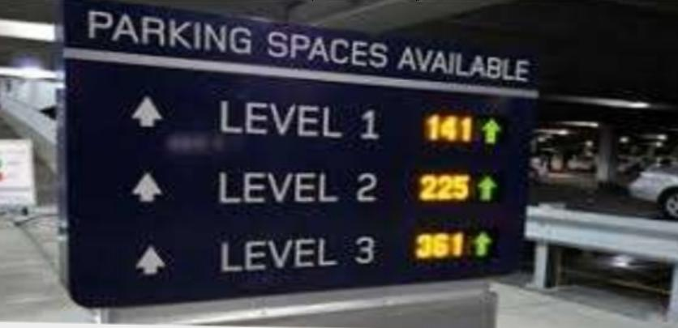
EXISTING SYSTEM
The problem in existing system is that the difference of availability and non availability of empty slots in the respective parking area

Slide 7
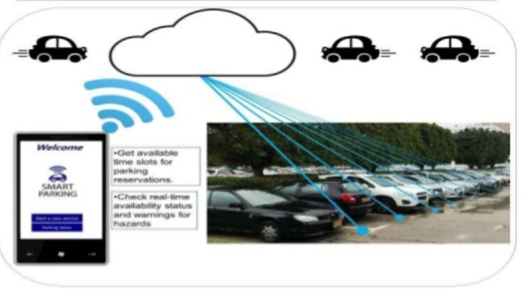
PROPOSED SYSTEM
To find the parking slots in the respective parking area using the smart phones.

Slide 8
INTERNET OF THINGS (IOT)
The Internet of things (IoT) is a system of interrelated computing devices, mechanical and digital machines provided with unique identifiers (UIDs) and the ability to transfer data over a network without requiring human-to-human or human-to-computer interaction. The definition of the Internet of things has evolved due to the convergence of multiple technologies, real-time analytics , machine learning , commodity sensors, and embedded systems. IoT technology is most synonymous with products pertaining to the concept of the “smart home", including devices and appliances (such as lighting fixtures, thermostats, home security systems and cameras, and other home appliances) that support one or more common ecosystems, and can be controlled via devices associated with that ecosystem, such as smartphone and smart speakers.

Slide 9
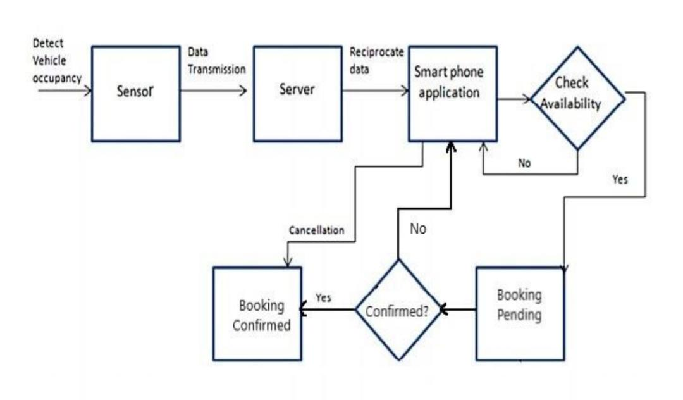
METHODOLOGY
BLOCK DIAGRAM :

Slide 10
METHODOLOGY DESCRIPTION
Designing the circuit and preparing the components.
Making simulations for the design.
Arranging circuit components together and connecting them.
Writing the Arduino code.
Project finishing, designing a smart parking system.

Slide 11
COMPONENT DESCRIPTION
HARDWARE :
Arduino Uno
GSM Module
Reader Module
Servo motor
Wifi Module
RFID Card
IR sensors
SOFTWARE :
Arduino IDE
MIT App inventor

Slide 12
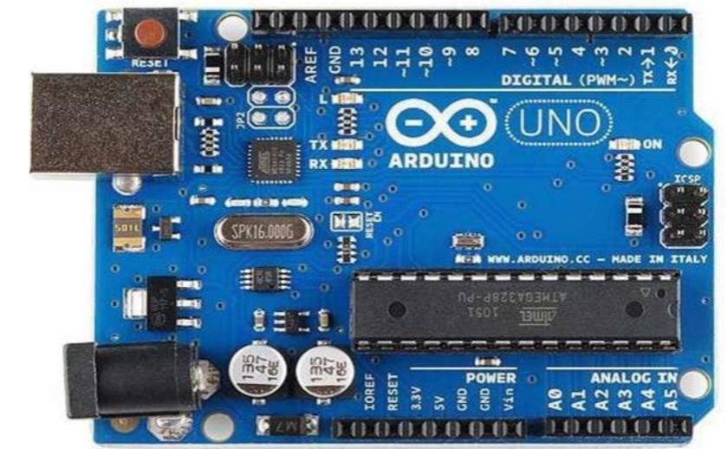
ARDUINO UNO
Microcontroller : ATmega328P
Operating voltage : 5v
Input voltage : 7-12v
Input voltage limit : 6-20v
Digital I/O pins : 6
Analogue input pins : 6
DC current per I/O pins : 20mA
DC current for 3.3v pin : 50mA
Clock speed : 16MHz
Length : 68.6mm
Width : 53.4mm
Weight : 25g

Slide 13
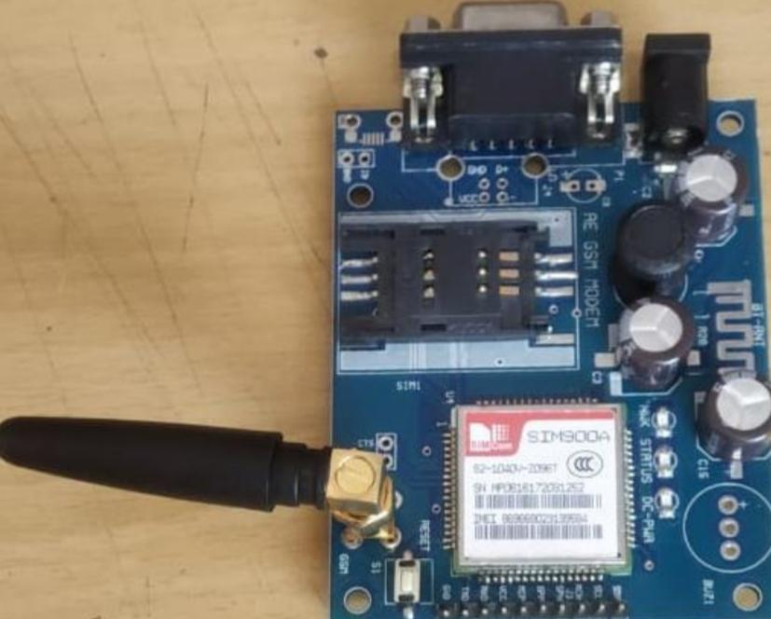
GSM MODULE
To setup communication between mobile phones and microcontroller.
It is used to send SMS, MMS and voice messages through mobile network.
GPRS extension in GSM allows high data transmission.

Slide 14
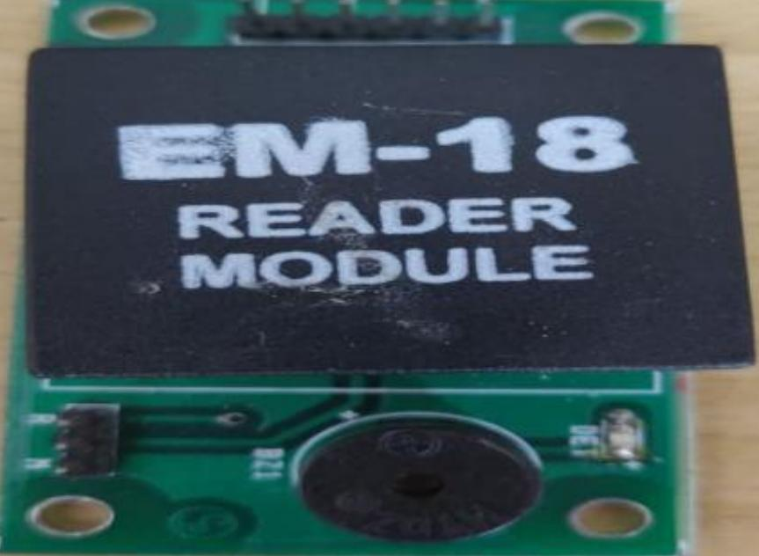
READER MODULE
Device that scans and gathers the information from the RFID Card.
This card can be used to track objects.

Slide 15
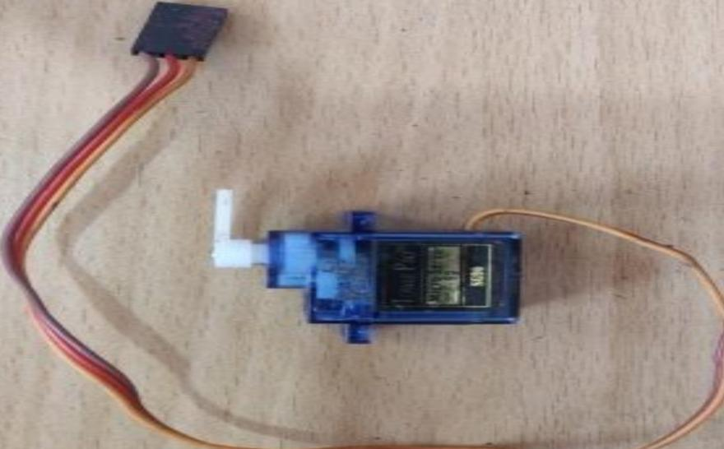
SERVO MOTOR
It is a rotator device that allows the control of angular as well as linear motion.
A servo motor is used for the opening and closing of the gate.

Slide 16
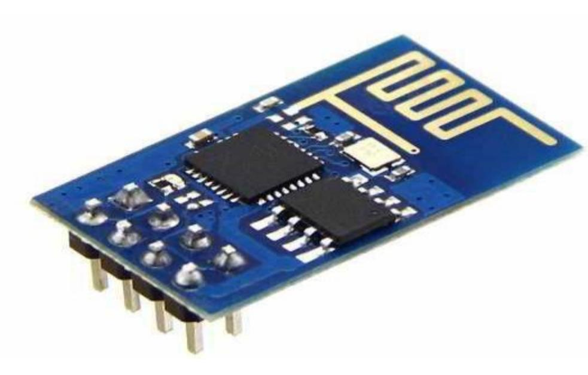
WIFI MODULE
ESP8266 wifi module is low cost standalone wireless transceiver that can be used for end-point IoT developments.
It uses TCP/UDP communication protocol to connect with server/client.
It is used to send data from embedded system to the internet using URL by HTTP POST method using TCP/IP protocol.

Slide 17
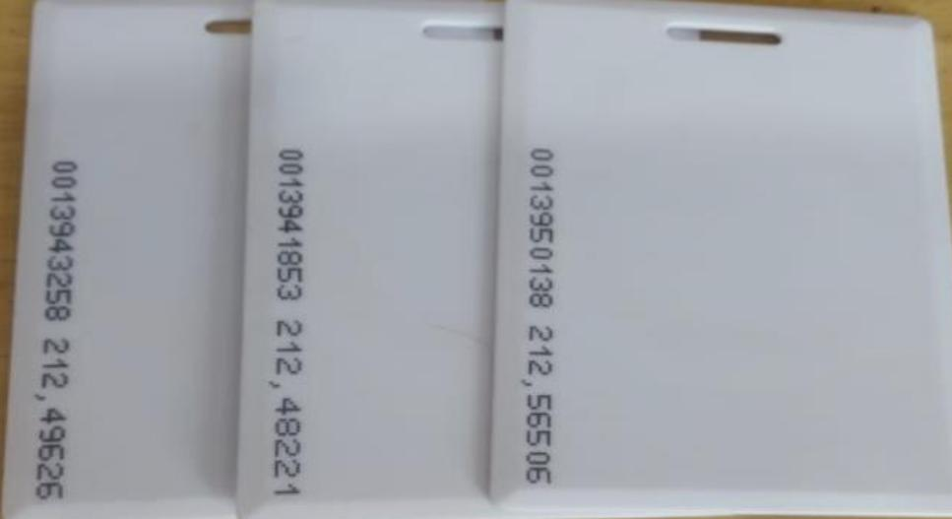
RFID CARDS
RFID tags are made up of integrated circuit (IC), an antenna, and a substrate.
It is an identification badge or credit card that transfers its contents about an object to the reader module.
RFID tag transfers data about an object through radio waves.

Slide 18
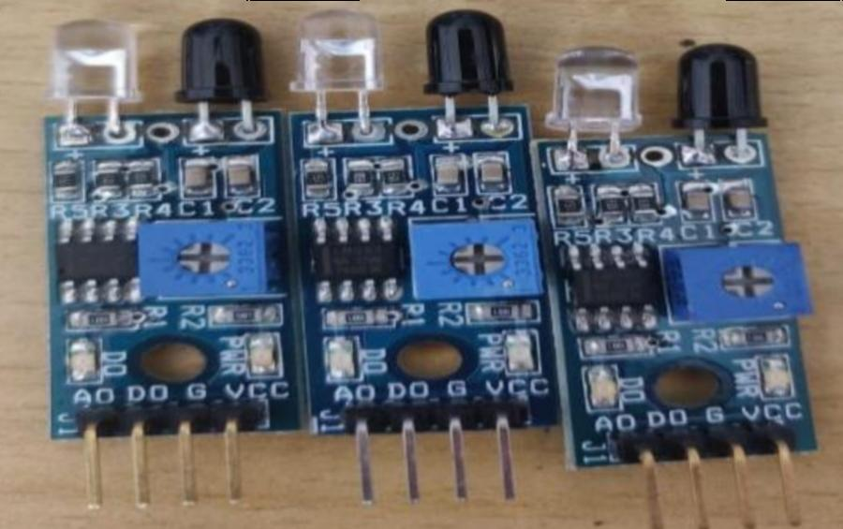
IR SENSORS
An infrared sensor is an electronic device which is used to detect the presence of objects.
If this device does not detect any IR light reflected back that means there is no object present.
If the light is detected by the sensor there is an object present.

Slide 19
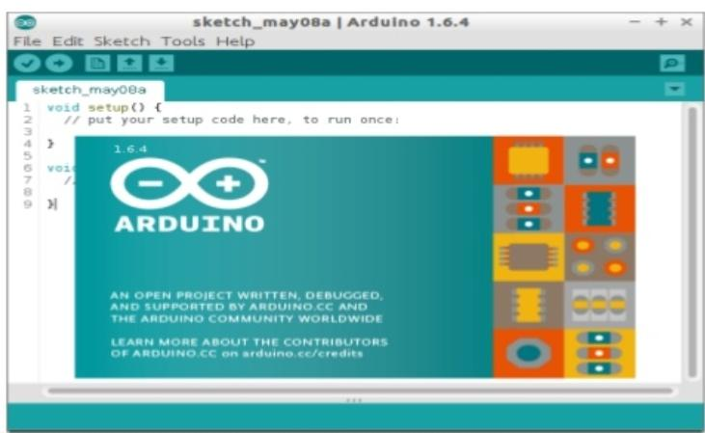
ARDUINO IDE
The Arduino Integrated Development Environment is a cross-platform application that is written in functions from C and C++.
It is used to write and upload programs to Arduino compatible boards, but also, with the help of 3rd party cores, other vendor development boards.

Slide 20
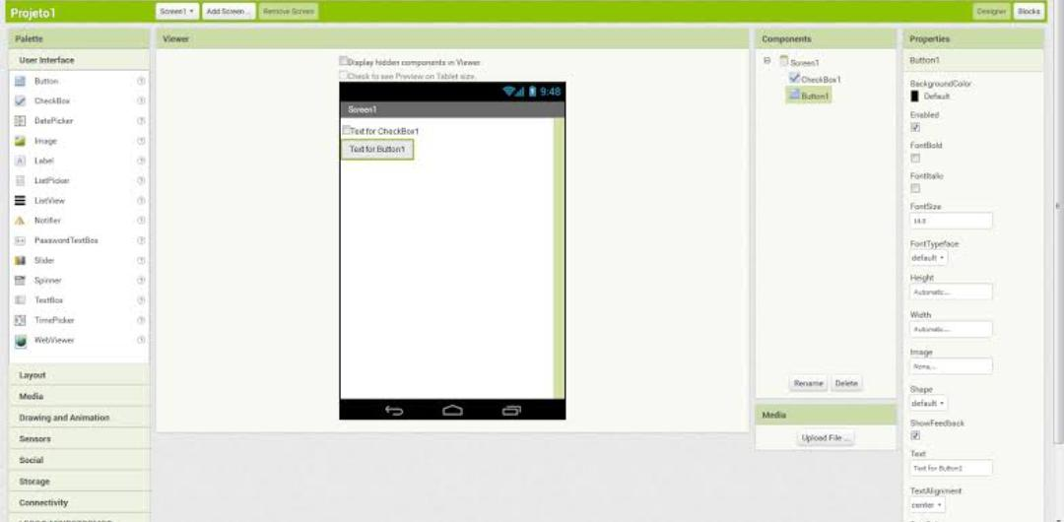
MIT APP INVENTOR
It is a web application integrated development environment originally provided by Google, and now maintained by the Massachusetts Institute of Technology.

Slide 21
PROJECT PLANNING
Implementation of proposed system.
To study hardware and software components.
Experimental setup of proposed design.
Checking the output by writing the appropriate code.
Result and discussion.

Slide 22
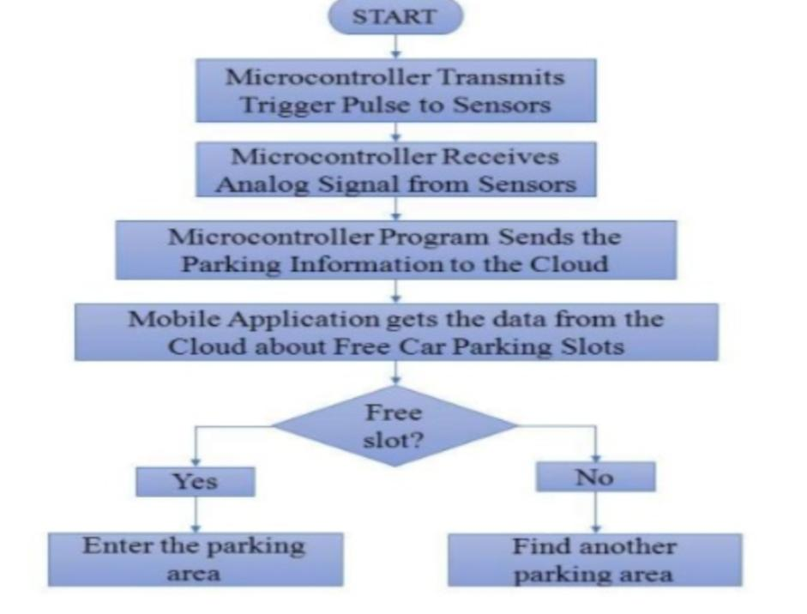
FLOWCHART

Slide 23
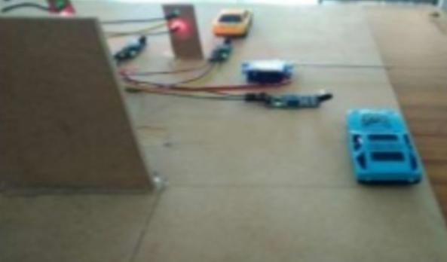
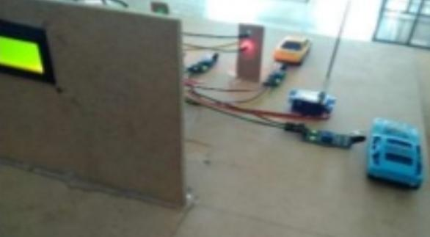
WORKING
Stage 1 :
When the car enters the parking area, IR sensors that is present IN gate will detect the passing of vehicle and the gate will be opened automatically.
Before reaching IN gate
After reaching IN gate

Slide 24
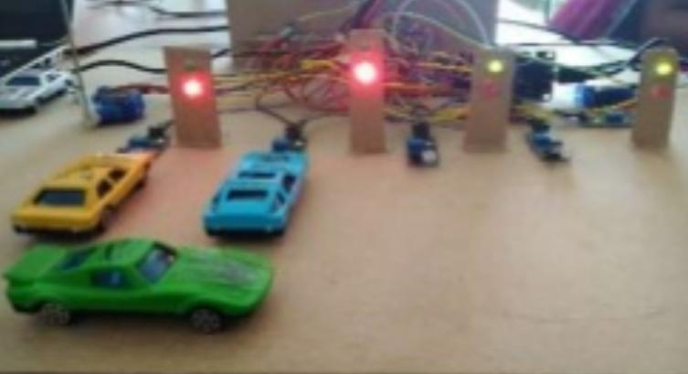
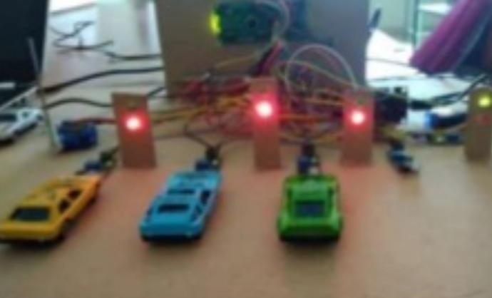
Stage 2 :
The car will enter into the parking area at that time the person will not be knowing which slot is empty, for this reason there will be an indication of LED’S for every slot, when the green light glows the slot is empty, If the red light glows the slot will be occupied, By this the person easily knows which slot is empty.
Before reaching to slot
After reaching to slot

Slide 25
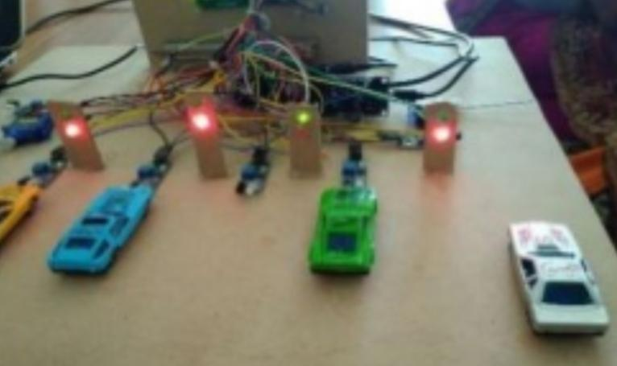
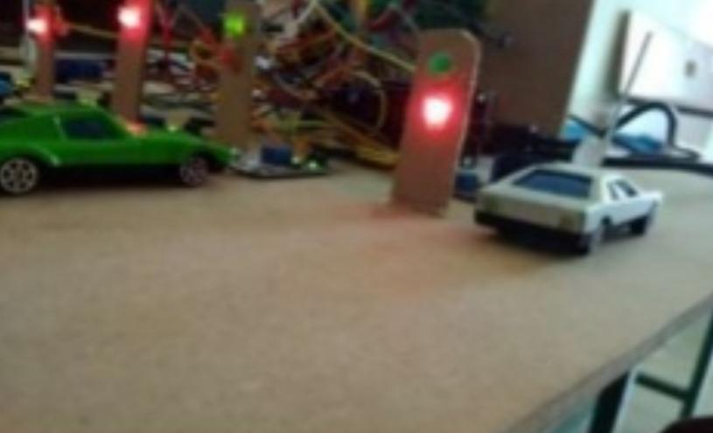
Stage 3 :
The operation of exit side will be same as that of the entrance. When the car is leaving the parking area, IR sensor that is present before the OUT gate will detect the passing of vehicle and the gate will be opened automatically.
Before reaching to OUT gate
After reaching to OUT gate

Slide 26
ADVANTAGES
Scalable Enterprise Architecture.
Highly customizable to any type of parking lot.
Entire Parking and billing can be done from customer’s perspective.
Less man-power to maintain the parking zone.
Manual operation is possible in case of failure of network, hardware etc.
Dedicated Surveillance system which can store the video data of 2 months duration.
Works in almost all weather conditions.

Slide 27
APPLICATIONS
The Smart parking system can be implemented in
Shopping malls
Theaters
Restaurants
Hospitals
Villas
Large scale companies

Slide 28
CONCLUSION
As for the future work the users can book a parking space from a remote location.GPS, reservation facilities and license plate scanner can be included in the future. This project focuses on implementation of car parking place detection using Internet of Things technology. By using IR sensor the parking place vacancy is detected and it is updated to the user using the mobile application.By using this application the parking area can be easily identified so the traffic is reduced and also carbon emission is also reduced. This project is low cost, low power consumption, more accurate and well suited for real time implementation.

Slide 29
REFERENCE
Asghar Ali Shah, G. M. (2019). Video Stitching with Localized 360o Model for Intelligent Car Parking Monitoring and Assistance System. IJCSNS International Journal of Computer Science and Network Security.
Bachhav. J. D. (2017). Smart Car Parking System. International Research Journal of Engineering and Technology (IRJET), 3.
R, M. B. (2015). Automatic Smart Parking System using Internet of Things (IOT). International Journal of Scientific and Research Publications.
Sadhukhan, P. (2017). An IoT-based E-Parking System for Smart Cities. Research gate.

Slide 30
THANK YOU

